Slide 1
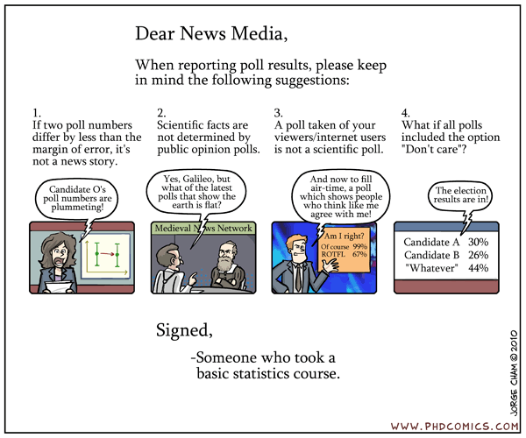

Slide 2
Statistics for humanities researchers
Lecture 1: Basics of quantitative methods

Slide 3


Us
Cognitive science
Philosophy
Psychology
A priori
Cognitive science
Semiotics
Language
Data

Slide 4
Course outline
Day 1 – Basics of quantitative methods
Philosophical assumptions
Research design
Lab 1 – how to approach a data set
Day 2 – Basic concepts for statistics
Samples and populations
Models and hypothesis testing
Lab 2 – testing assumptions and hypotheses
Day 3 – Towards the General Linear Model
Correlation
Regression
GLM
Lab 3 – correlation and regression
Day 4 – The General Linear Model
Analysis of Variance
Factorial ANOVA
Contrasts and post-hoc tests
Lab 4 – analysis of variance
Day 5 – Mixed Effects Models
Heirarchical models
Non-linear models
Other odds and ends
Lab 5 – mixed effects model

Slide 5
What will this course be like
A lot of information
A lot of collaboration
Exercises
Open group work
A lot of basics
Concepts build on one another – progressive
3 methods courses worth of content
Not much time
Not much math
Some mathematical explanation

Slide 6
Today’s outline
Philosophical assumptions
Brief humanistic introduction to the logic of quantitative research
Research design
Logic in practice
Lab 1 – How to approach a data set

Slide 7
Today’s outline
Philosophical assumptions
Brief humanistic introduction to the history/logic of quantitative research
Research design
Logic in practice
Lab 1 – How to approach a data set

Slide 8
Quantitative methods: the natural sciences model
Observation
Explanation
Prediction
Control

Slide 9
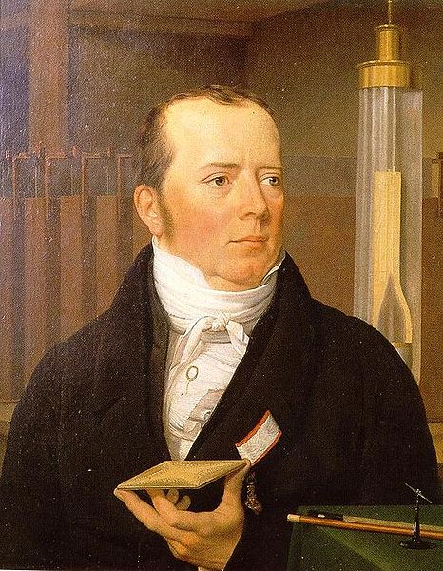
Quantitative methods: the natural sciences model
Observation
See a phenomenon in the world
E.g. electric fields induce magnetic changes
Explanation
Construct a theoretical account
E.g. theory of electrodynamics
Prediction
Use the theory to predict new and surprising phenomena
E.g. moving charge induces a magnetic field
Control
Harness the new knowledge to better the lot of humanity
E.g. electric motor

Slide 10
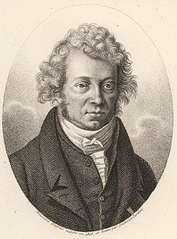
Quantitative methods: the natural sciences model
Observation
See a phenomenon in the world
E.g. electric fields induce magnetic changes
Explanation
Construct a theoretical account
E.g. theory of electrodynamics
Prediction
Use the theory to predict new and surprising phenomena
E.g. moving charge induces a magnetic field
Control
Harness the new knowledge to better the lot of humanity
E.g. electric motor

Slide 11
Quantitative methods: the natural sciences model
Observation
See a phenomenon in the world
E.g. electric fields induce magnetic changes
Explanation
Construct a theoretical account
E.g. theory of electrodynamics
Prediction
Use the theory to predict new and surprising phenomena
E.g. moving charge induces a magnetic field
Control
Harness the new knowledge to better the lot of humanity
E.g. electric motor

Slide 12
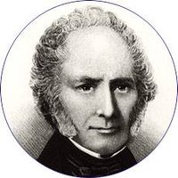
Quantitative methods: the natural sciences model
Observation
See a phenomenon in the world
E.g. electric fields induce magnetic changes
Explanation
Construct a theoretical account
E.g. theory of electrodynamics
Prediction
Use the theory to predict new and surprising phenomena
E.g. moving charge induces a magnetic field
Control
Harness the new knowledge to better the lot of humanity
E.g. electric motor

Slide 13
Quantitative methods: the natural sciences model
Observation
See a phenomenon in the world
E.g. electric fields induce magnetic changes
Explanation
Construct a theoretical account
E.g. theory of electrodynamics
Prediction
Use the theory to predict new and surprising phenomena
E.g. moving charge induces a magnetic field
Control
Harness the new knowledge to better the lot of humanity
E.g. electric motor
Uses math

Slide 14
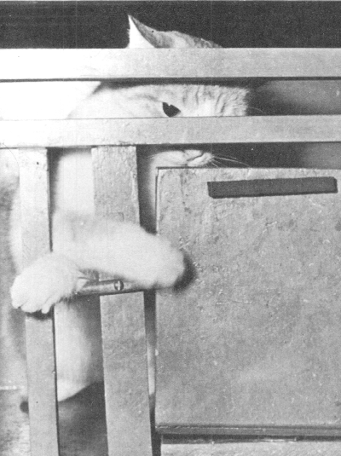
Social science on the natural science model
Observation
See a phenomenon in the world
E.g. cats take less and less time to escape from a box
Explanation
Construct a theoretical account
E.g. law of effect
Prediction
Use the theory to predict new and surprising phenomena
E.g. reinforcing a behaviour will increase frequency of occurance
Control
Harness the new knowledge to better the lot of humanity
E.g. technology of behaviour

Slide 15
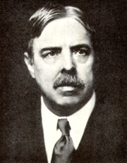
Social science on the natural science model
Observation
See a phenomenon in the world
E.g. cats take less and less time to escape from a box
Explanation
Construct a theoretical account
E.g. law of effect
Prediction
Use the theory to predict new and surprising phenomena
E.g. reinforcing a behaviour will increase frequency of occurance
Control
Harness the new knowledge to better the lot of humanity
E.g. technology of behaviour

Slide 16
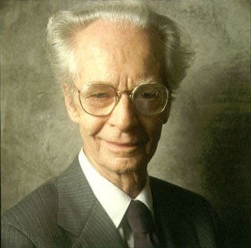
Social science on the natural science model
Observation
See a phenomenon in the world
E.g. cats take less and less time to escape from a box
Explanation
Construct a theoretical account
E.g. law of effect
Prediction
Use the theory to predict new and surprising phenomena
E.g. reinforcing a behaviour will increase frequency of occurance
Control
Harness the new knowledge to better the lot of humanity
E.g. technology of behaviour

Slide 17
Social science on the natural science model
Observation
See a phenomenon in the world
E.g. cats take less and less time to escape from a box
Explanation
Construct a theoretical account
E.g. law of effect
Prediction
Use the theory to predict new and surprising phenomena
E.g. reinforcing a behaviour will increase frequency of occurance
Control
Harness the new knowledge to better the lot of humanity
E.g. technology of behaviour

Slide 18


Social science on the natural science model
Observation
See a phenomenon in the world
E.g. cats take less and less time to escape from a box
Explanation
Construct a theoretical account
E.g. law of effect
Prediction
Use the theory to predict new and surprising phenomena
E.g. reinforcing a behaviour will increase frequency of occurance
Control
Harness the new knowledge to better the lot of humanity
E.g. technology of behaviour
???

Slide 19

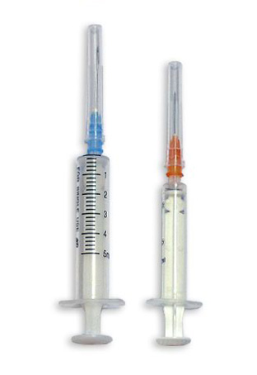
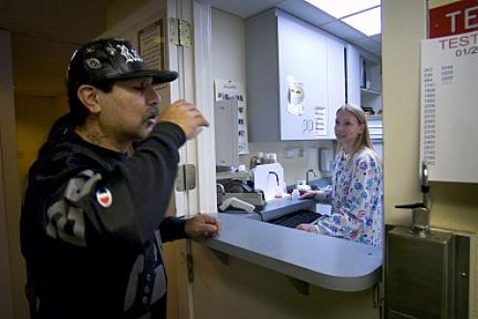
Social policy on the natural sciences model
Observation
See a phenomenon in the world
E.g. Crime increase
Explanation
Construct a theoretical account
E.g. lncreased drug addiction
Prediction
Use the theory to predict new and surprising phenomena
E.g. Methadone clinic will decrease crime
Control
Harness the new knowledge to better the lot of humanity
E.g. set up more methadone clinics

Slide 20

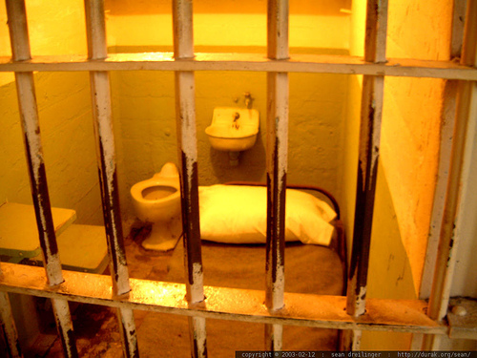
Social policy on the natural sciences model
Observation
See a phenomenon in the world
E.g. Crime increase
Explanation
Construct a theoretical account
E.g. Punishment too lenient
Prediction
Use the theory to predict new and surprising phenomena
E.g. Harsher sentences will reduce crime
Control
Harness the new knowledge to better the lot of humanity
E.g. Harsher criminal law

Slide 21
An liberal alternative to control
Control
Inform decisions - counsel
Risk of error
Control requires regime implementation
Small errors could ruin society
Risk of incompleteness
Regime implementation requires complete theory
No room for assumptions, but assumptions required
Risk of paternalism
Science as an institutionalised authority
Knowledge and power in the hands of social engineers
Violation of individual
Risk of error
Acknowledge fallibility and try to quantify uncertainty
Publicise success/failure rate
Risk of incompleteness
Acknowledge ignorances
Make the gaps explicit
Publicise assumptions
Risk of paternalism
Science as a publically available good
Knowledge available to a generally educated public – open science
Leave the decision up to the individual

Slide 22
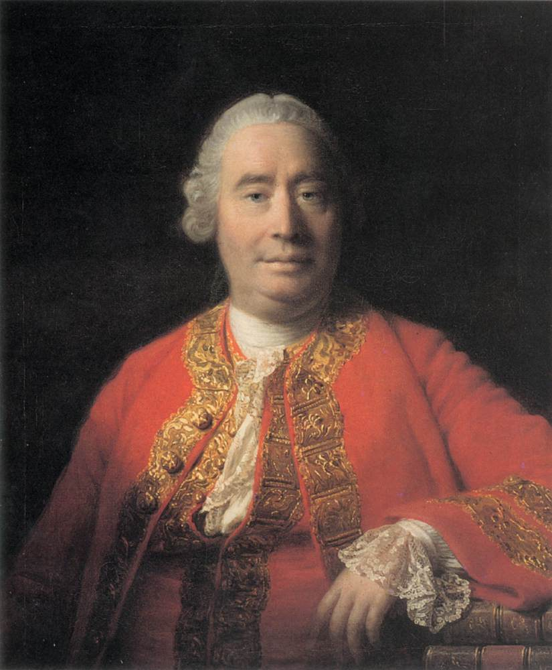
Limitations on even a liberalised quantitative methods
Numbers cannot settle issues of value
20% more just, beautiful, or moral
There is room for interpretation in ANYdata set
Even what CERN produces
Some phenomena cannot be directly quantified
Happiness
Anything psychological
Anything involving social constructions
Most of sociology

Slide 23
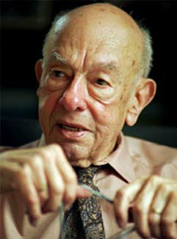
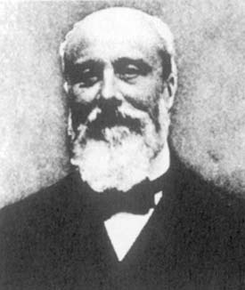
Limitations on even a liberalised quantitative methods
Numbers cannot settle issues of value
20% more just, beautiful, or moral
There is room for interpretation in ANYdata set
Even what CERN produces
Some phenomena cannot be directly quantified
Happiness
Anything psychological
Anything involving social constructions
Most of sociology
+

Slide 24
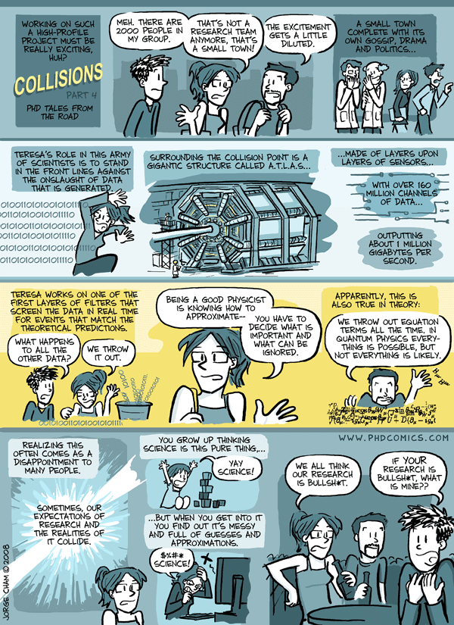
Teresa: a CERN post-doc
www.phdcomics.com

Slide 25
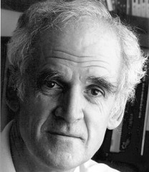
Limitations on even a liberalised quantitative methods
Numbers cannot settle issues of value
20% more just, beautiful, or moral
There is room for interpretation in ANYdata set
Even what CERN produces
Some phenomena cannot be directly quantified
Happiness
Anything psychological
Anything involving social constructions
Most of social sciences
+

Slide 26
Two groups of problems
How should social scientists approximate in their research?
How do you do quantitative research on things that are not quantities?

Slide 27
Two groups of problems
How should social scientists approximate in their research?
How do you do quantitative research on things that are not quantities?

Slide 28
What’s being a “good social scientist” – how to approximate
Basic intuition
Science discovers causes
Manipulate cause and measure effect
Empiricism
Basic intuition is wrong
Can’t know causes
Know constant conjunction
Imagine causes
Positivism
Scientific practice is not about causes
Scientific practice is about manipulating and measuring variables
Replace causal talk with talk about variables

Slide 29
What’s being a “good social scientist” – how to approximate
Basic intuition
Science discovers causes
Manipulate cause and measure effect
Empiricism
Basic intuition is wrong
Can’t know causes
Know constant conjunction
Imagine causes
Positivism
Scientific practice is not about causes
Scientific practice is about manipulating and measuring variables
Replace causal talk with talk about variables

Slide 30
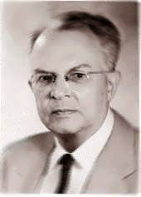
What’s being a “good social scientist” – how to approximate
Basic intuition
Science discovers causes
Manipulate cause and measure effect
Empiricism
Basic intuition is wrong
Can’t know causes
Know constant conjunction
Imagine causes
Positivism
Scientific practice is not about causes
Scientific practice is about manipulating and measuring variables
Replace causal talk with talk about variables

Slide 31
What’s being a “good social scientist” – how to approximate
Basic intuition
Science discovers causes
Manipulate cause and measure effect
Empiricism
Basic intuition is wrong
Can’t know causes
Know constant conjunction
Imagine causes
Positivism
Scientific practice is not about causes
Scientific practice is about manipulating and measuring variables
Replace causal talk with talk about variables
Functional analysis
Effect: Measured variable = dependant variable
Cause:Manipulated variable = independent variable
Science: explanation, prediction, and control of dependant variables, in terms of independent variables

Slide 32
What’s being a “good social scientist” – how to approximate
Example: Gender equality in the workplace
Functional analysis
Dependant variable
Yearly income
Independent variable
Gender (male, female)
Country (Australia, Denmark)
Possible finding
There is greater gender equality in the Australian/Danish labour market
Effect: Measured variable = dependant variable
Cause:Manipulated variable = independent variable
Science: explanation, prediction, and control of dependant variables, in terms of independent variables
Heart and soul of quantitative methods

Slide 33
Two groups of problems
How should social scientists approximate in their research?
How do you do quantitative research on things that are not quantities?

Slide 34
Who spotted the trick?
Example: Gender equality in the workplace
Dependant variable
Yearly income
Independent variable
Gender (male, female)
Country (Australia, Denmark)
Possible finding
There is greater gender equality in the Australian/Danish labour market

Slide 35
The trick
Example: Gender equality in the workplace
Dependant variable
Yearly income
Independent variable
Gender (male, female)
Country (Australia, Denmark)
Possible finding
There is greater gender equality in the Australian/Danish labour market

Slide 36
The trick: operational definitions
Example: Gender equality in the workplace
Operational definitions
Dependant variable
Yearly income
Independent variable
Gender (male, female)
Country (Australia, Denmark)
Possible finding
There is greater gender equality in the Australian/Danish labour market
Can you quantify “equality” directly?
Can “equality” be a dependant variable?
Can you quantify yearly income directly?
Can income be a dependant variable?
Can we define equality in terms of yearly income?
Income operates as a variable for measuring equality.
Equality operationally defined in terms of income.

Slide 37
Two classical methodological criteria
Operationalism
Universalism
If….
we operationally define a concept that cannot be quantified, in terms a variable than can be quantified
And….
our operational definition sufficiently captures the relevant aspects of the concept we are trying to measure
Then….
What we learn about the variable can be inferred to hold for the concept
And….
Our functional analysis has meaning in the real world
If….
scientific method is the best model of knowledge
And….
we have applied it correctly when conducting research
Then….
what we learn during an experiment about a sample of behaviours from a sample of people can be universalised to the behaviour of people in the population the sample comes from
And....
Our findings have meaning in the real world

Slide 38
Today’s outline
Philosophical assumptions
Brief humanistic introduction to the history/logic of statistical research
Research design
Logic in practice
Lab 1 – How to approach a data set

Slide 39
How does the logic of quantitative methods constrain practice?
Functional analysis
Methodological criteria
The way you treat the variables in your study shape the kind of functional analysis you do
Kinds of dependent variables
Things to do with independent variables
Dealing with confounding variables
Operationalism and universalism are relevant to the validity and reliability of quantitative research.
Types of validity and reliability, and their relations to the methodological criteria
Kinds of validity connected to different kinds of studies

Slide 40
How does the logic of quantitative methods constrain practice?
Functional analysis
Methodological criteria
The way you treat the variables in your study shape the kind of functional analysis you do
Kinds of dependent variables
Things to do with independent variables
Dealing with confounding variables
Operationalism and universalism are relevant to the validity and reliability of quantitative research.
Types of validity and reliability, and their relations to the methodological criteria
Kinds of validity connected to different kinds of studies

Slide 41
Functional analysis: kinds of dependent variables
Categorical scales

Slide 42
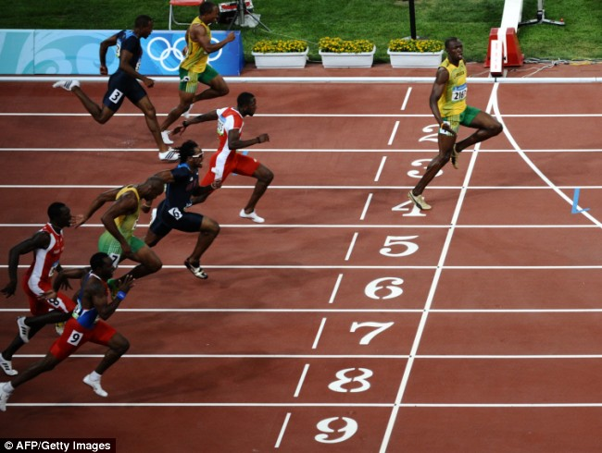
Functional analysis: kinds of dependent variables
Categorical scales
Team C
Team A
Nominal scale (i.e. name)
No meaningful quantitativerelationship between categories
Ordinal scale (i.e. order)
Categories ranked in order
No meaningful distance between categories
E.g. order participants finish
E.g. 1st→ 2nd ~= 2nd→3rd
Team B

Slide 43
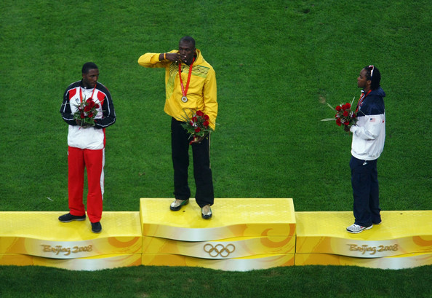
Functional analysis: kinds of dependent variables
Categorical scales
Nominal scale (i.e. name)
No meaningful quantitativerelationship between categories
Ordinal scale (i.e. order)
Categories ranked in order
No meaningful distance between categories
E.g. 1st→ 2nd ~= 2nd→3rd

Slide 44
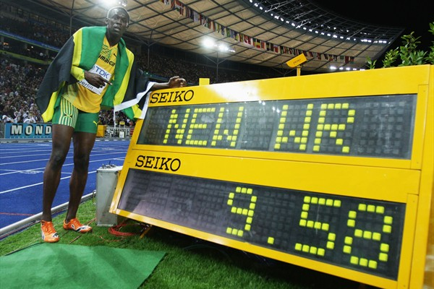
Functional analysis: kinds of dependent variables
Categorical scales
Continuous scales
Nominal scale (i.e. name)
No meaningful quantitativerelationship between categories
Ordinal scale (i.e. order)
Categories ranked in order
No meaningful distance between categories
E.g. 1st→ 2nd ~= 2nd→3rd
Interval scale
Scale divided evenly into points
Regular distance between points on the scale
Physically arbitrary zero point
(Division not meaningful)
E.g. degrees Celsius
Ratio data
Physically meaningful zero
Division meaningful
E.g. degrees Kelvin
Never happens in social science

Slide 45
Functional analysis: kinds of dependent variables
Categorical scales
Continuous scales
Nominal scale (i.e. name)
No meaningful quantitativerelationship between categories
Ordinal scale (i.e. order)
Categories ranked in order
No meaningful distance between categories
E.g. 1st→ 2nd ~= 2nd→3rd
Interval scale
Scale divided evenly into points
Regular distance between points on the scale
Physically arbitrary zero point
(Division not meaningful)
E.g. degrees Celsius
Ratio data
Physically meaningful zero
(Division meaningful)
E.g. degrees Kelvin

Slide 46
Functional analysis: kinds of dependent variables (examples)
Nominal scale
Gender
Political party
Nationality
Occupation
Allele (i.e. type of gene)
Ordinal scale
Rank in hierarchy (e.g. work, club, tribe etc)
Attractiveness
Questionnaire data???
Relative biological fitness
Interval scale
Consumption (e.g. goods, services, etc)
Production
Response time
Number of correct responses
Questionnaire data???
Number of births

Slide 47
Functional analysis: kinds of dependent variables (examples)
Nominal scale
Gender
Political party
Nationality
Occupation
Allele (i.e. type of gene)
Ordinal scale
Rank in hierarchy (e.g. work, club, tribe etc)
Attractiveness
Questionnaire data???
Relative biological fitness
Interval scale
Consumption (e.g. goods, services, etc)
Production
Response time
Number of correct responses
Questionnaire data???
Number of births
Different kinds of statistics

Slide 48
How does the logic of quantitative methods constrain practice?
Functional analysis
Methodological criteria
The way you treat the variables in your study shape the kind of functional analysis you do
Kinds of dependent variables
Things to do with independent variables
Dealing with confounding variables
Operationalism and universalism are relevant to the validity and reliability of quantitative research.
Types of validity and reliability, and their relations to the two methodological criteria
Kinds of validity connected to different kinds of studies

Slide 49

Functional analysis: what to do with independent variables
Lets say you want to study…….
………. keep an eye out for new terms that we’ll use later

Slide 50
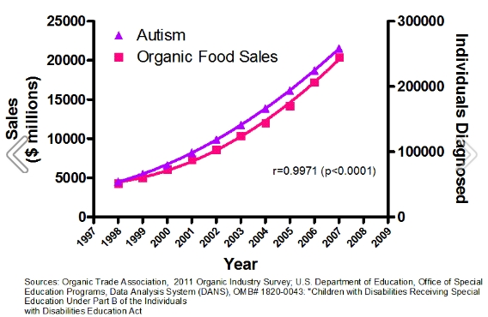
Functional analysis: what to do with independent variables
Leave them out
Observation
Correlate two or more dependent variables
E.g. correlate vaccine use and autism prevalence
Correlational design
Manipulate the same subjects
Experiment
Measure the effects of vaccine use on autism prevalence
E.g. measure autism rate, vaccinate, then measure again
Within subjects design
Manipulate different subjects
E.g. vaccination group, placebo group, compare
Between subjects design

Slide 51
How does the logic of quantitative methods constrain practice?
Functional analysis
Methodological criteria
The way you treat the variables in your study shape the kind of functional analysis you do
Kinds of dependent variables
Things to do with independent variables
Dealing with confounding variables
Operationalism and universalism are relevant to the validity and reliability of quantitative research.
Types of validity and reliability, and their relations to the two methodological criteria
Kinds of validity connected to different kinds of studies

Slide 52
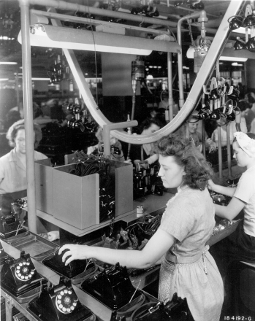
Functional analysis: dealing with confounding variables
The study
Do lighting conditions affect productivity?
The dependent variable
Unit output
The independent variable
Lighting
What happened
Productivity increased during the study
No change when implemented in the factory

Slide 53
Functional analysis: dealing with confounding variables
The study
Do cleaner workspaces affect productivity?
The dependent variable
Unit output
The independent variable
Cleaning frequency
What happened
Productivity increased during the study
No change when implemented in the factory

Slide 54
Functional analysis: dealing with confounding variables
The study
Do longer breaks affect productivity?
The dependent variable
Unit output
The independent variable
Break duration
What happened
Productivity increased during the study
No change when implemented in the factory
Workers in the study got management’s attention!
The “Hawthorne effect”
Attention “confounded” (i.e. confused) the IV

Slide 55
Functional analysis: dealing with confounding variables
Always a problem
Intervening variables
Confounding Variable → Independent Variable → Dependent Variable
Smoking → ashtrays → lung cancer
Hawthorne effect: managers care → study IV → increased productivity
Demand characteristics
Hawthorne effect (the other interpretation)
People want to help in the experiment
Placebo effect
People believe the experiment will work
People want to look good
Differential mortality
Types of participant might just drop out

Slide 56
Functional analysis: dealing with confounding variables
Within subjects problems – time effects
Practice
If you do something twice you get better
History
E.g. Christchurch earthquake
Regression to the mean
Extreme scores might be random blips
Maturation
People change
Age and political preference
E.g. income increases over time

Slide 57
2) Regression toward the mean
Consider the following….
One year there is a significant increase in crime
The Mayor pledges more money to fight crime
Crime decreases the following year
Is the Mayor responsible?
Not necessarily…

Slide 58
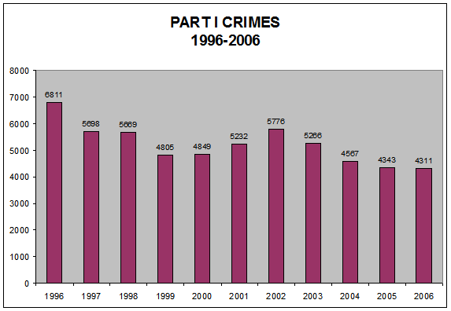
Odessa, Texas
Statistical fluctuation

Slide 59
Regression toward the mean
What is it?
Extreme measurements tend to be followed by measurements that are closer to the population average
All else being equal: big increases are usually followed by big decreases

Slide 60
Functional analysis: dealing with confounding variables
Within subjects problems – time effects
Between subjects problems – pre-existing differences
Practice
If you do something twice you get better
E.g. IQ test
History
E.g. Christchurch earthquake
Regression to the mean
Extreme scores might be random blips
Maturation
People change
Age and political preference
E.g. income increases over time
Pre-existing differences
Special case of intervening variable
Independent variable highly correlated with something irrelevant to question
E.g.: Stimulant use in ADHD research
Between subjects studies always have this risk
More random differences than just the independent variable

Slide 61
Functional analysis: dealing with confounding variables
Control group/session
Only difference is what you test
ADHD example: test another population who are prescribed stimulants
Helps fix
Demand characteristics
Intervening variables
Pseudo-randomise
“Any variable you can’t control, randomise”
Be sure to evenly distribute properties
Helps fix
Intervening variables
Time effects
Pre-existing differences
Measure co-variates
Treat possible intervening variables as dependent variables
Correlate with dependent variable
Measure effect of treatment “over and above” intervening variable
E.g. do ashtrays cause cancer: how does number of cigarettes per day co-vary with ashtrays and cancer?
Helps fix
Pre-existing differences
Intervening variables

Slide 62
Summary
Control condition
Demand characteristics
Intervening variables
Pseudo-randomisation
Time effects
Intervening variables
Pre-existing differences
Covariance
Intervening variables
Pre-existing differences

Slide 63
How does the logic of quantitative methods constrain practice?
Functional analysis
Methodological criteria
The way you treat the variables in your study shape the kind of functional analysis you do
Kinds of dependent variables
Things to do with independent variables
Dealing with confounding variables
Operationalism and universalism are relevant to the validity and reliability of quantitative research.
Types of validity and reliability, and their relations to the two methodological criteria
Kinds of validity connected to different kinds of studies

Slide 64
Methodological criteria, validity, and reliability
Operationalism
Universalism
If….
we operationally define a concept that cannot be quantified, in terms a variable than can be quantified
And….
our operational definition sufficiently captures the relevant aspects of the concept we are trying to measure
Then….
What we learn about the variable can be inferred to hold for the concept
And….
Our functional analysis has meaning in the real world
If….
scientific method is the best model of knowledge
And….
we have applied it correctly when conducting research
Then….
what we learn during an experiment about a sample of behaviours from a sample of people can be universalised to the behaviour of people in the population the sample comes from
And....
Our findings have meaning in the real world

Slide 65
Methodological criteria, validity, and reliability
How do these constrain an experiment’s
Internal validity
Construct/content
Criterion
External validity
Reliability

Slide 66
Methodological criteria, validity, and reliability
Construct/content validity
Relationship between the construct and the operational definition of it?
Does the operational definition represent the concept being studied?
Is the operational definition any good?

Slide 67


Slide 68
Methodological criteria, validity, and reliability
Construct/content validity
Examples – which measure has better construct validity?
Relationship between the construct and the operational definition of it?
Does the operational definition represent the concept being studied?
Is the operational definition any good?
Quality of a city’s singles market
1) Average income of singles
2) Number of single people
Gender equality in labour market
1) Relative income between genders
2) % exec. positions between genders
Ecological behaviour
1) Average engine capacity of cars
2) Frequency of public transport

Slide 69
Methodological criteria, validity, and reliability
Criterion validity
Examples
How well does your specific measurement capture the outcome you want it to?
Are you really measuring what you think you are measuring?
Does your measurment predict relevant outcomes
SATs and first year GPA
IQ scores and school performance

Slide 70
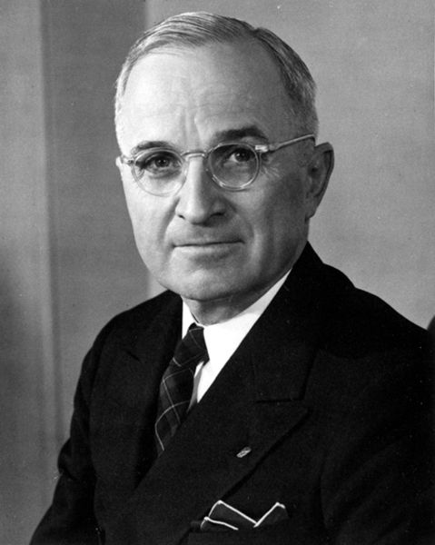
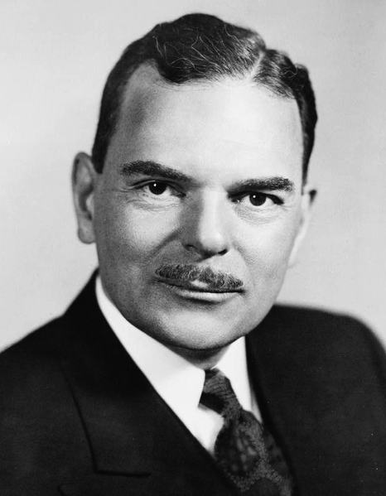
Methodological criteria, validity, and reliability
External validity
Example – 1948 US election
How well do the results of your quantitative study generalise?
Can you infer that what you have learned about the sub-group of people you studied (“the sample”) applies to the group of people you’re interested in (“the population”)
Study 70 Danes → all Danes
Study 70 Women → all women
Truck drivers
Humans
Primates
Etc.
Polls showed Dewey to win by a landslide
Chicago Tribune pre-prepared headline “Dewey defeats Truman”

Slide 71
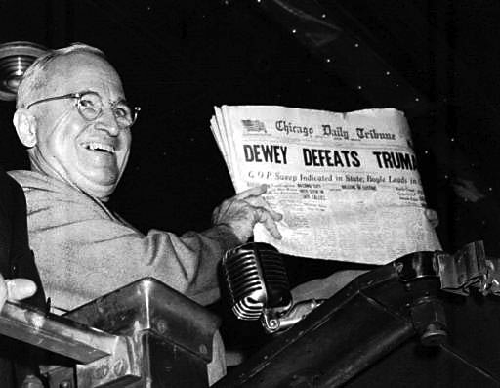
What happened

Slide 72
Methodological criteria, validity, and reliability
External validity
What went wrong
How well do the results of your quantitative study generalise?
Can you infer that what you have learned about the sub-group of people you studied (“the sample”) applies to the group of people you’re interested in (“the population”)
Study 70 Danes → all Danes
Study 70 Women → all women
Truck drivers
Humans
Primates
Etc.
Polls were conducted by phone
Only rich people had phones
Poor people voted for Truman
Sample did not represent population
Pre-existing difference confounded the poll

Slide 73
Methodological criteria, validity, and reliability
Reliability
Example
Will your experiment produce the same results under the same conditions?
Can you depend on your dependant variable?
How much intrinsic noise is in your measure?
Is your measure consistent across time?
IQ tests
Personality tests
Political preferences

Slide 74
Methodological criteria, validity, and reliability
Ecological validity
Importance – MYPERSONAL OPINION
Do the conditions in the experiment reflect the conditions in the real world?
E.g. effect of commercials on buying behaviour
Are commercials shown during a break in a tv show
Often thought to be crucial for the generalisability of an experiment
Not = external reliability
that’s about the relationship between samples and populations
This is about experimental conditions
Not a good in itself
Not necessary for generalisability
All we need are internal validity, external validity, and reliability
May be sufficient
Only by its effect on other kinds of validity
Not a criticism of an experiment that it is not ecologically valid
Good heuristic for improving external and internal validity, but not an end in itself

Slide 75
Methodological criteria, validity, and reliability
Concept
Theory
Construct validity
OPERATIONALISM
Operational definition
Criterion validity
Dependant variable measured in a sample
Sample
data
External validity
UNIVERSALISM
Population in real world
Reliability
Population at relevant times
“Reality”

Slide 76
Methodological criteria, validity, and reliability
Concept
Theory
Construct validity
Operational definition
Criterion validity
Dependent variable measured in a sample
Sample
data
External validity
Population in real world
Reliability
Population at relevant times
“Reality”

Slide 77
Methodological criteria, validity, and reliability
Concept
Theory
Operational definition
Dependent variable measured in a sample
Sample
data
Population in real world
Population at relevant times
“Reality”

Slide 78
Methodological criteria, validity, and reliability
Assumed philosophy of science
Concept
Theory
Knowledge of reality is based on concepts that are built up on and mediated by empirical data
Operational definition
Dependent variable measured in a sample
Sample
data
Population in real world
Population at relevant times
“Reality”

Slide 79
How does the logic of quantitative methods constrain practice?
Functional analysis
Methodological criteria
The way you treat the variables in your study shape the kind of functional analysis you do
Kinds of dependent variables
Things to do with independent variables
Dealing with confounding variables
Operationalism and universalism are relevant to the validity and reliability of quantitative research.
Types of validity and reliability, and their relations to the two methodological criteria
Kinds of validity connected to different kinds of studies

Slide 80
Validity in different types of study
Types of study
Experiment
Observation
Quasi-experimental design

Slide 81
Validity in different types of study
What’s an experiment
Example – attractiveness on facebook
Clear distinction between dependent and independent variables
Clear distinction between what’s being measured and what’s being manipulated
Can make inferences about “cause” and “effect”
Viewing habits for attractive and unattractive facebook profiles
Manipulate attractiveness of fake profile picture into 2 groups
Measure eye movements and viewing time for each group
Does attractiveness cause viewing behaviour?

Slide 82
Validity in different types of study
What’s an observation
Example – attractiveness on facebook
No independent variables, only dependent variables
Nothing is manipulated, measure things as they spontaneously occur, when they occur
No cause, only correlation
Viewing habits of attractive and unattractive facebook profiles
No control over profiles viewed
Measure viewing time for different real profiles from ISP usage logs, rate attractiveness later
Is there a correlation between attractiveness of the profile picture and the way it is viewed?

Slide 83
Validity in different types of study
What’s a quasi-experiment?
Example – attractiveness on facebook
Independent variables, but limited experimenter control
Some rights to causal claims
Compromise
Viewing habits of attractive and unattractive facebook profiles
Make 2 loosely defined groups of fake profiles, one attractive and the other not
Put them on facebook
Is there a relationship between attractiveness of the profile and the way it is viewed?

Slide 84
Validity in different types of study
Observation
Better external validity
Worse internal validity
Experiment
Worse external validity
Better internal validity
May be impossible
Manipulation might be unethical
Quasi-experimental design
Compromise
Use as much control as you can

